Slide 1
Creating a BLE112 Project

Slide 2
BLE112 Projects – Where to start?
What is a project?
A project is a collection of files together will define the BLE112’s functionality for a given application
What is the structure of a BLE112 project?
A main project file is an XML file with references to associated files
An example project file is as follows:
<project>
<gatt in=“gatt.xml” />
<hardware in=“hardware.xml” />
<script in=“bgdemo.bgs” />
<usb_main in=“cdc.xml” />
<image out=“out.hex” />
</project>
Notes:
The project configuration is described within the <project> tags
<gatt> tag defines the .XML file containing the GATT data base description (REQUIRED)
<hardware> tag defines the .XML file containing the hardware configuration (REQUIRED)
<script> tag defines the .BGS file containing the BGScript code.
If the project does not contain a BGScript code, this tag can be simply left out.
<usb_main> tag defines the .XML file containing the USB descriptors description.
If the project does not use USB interface, this tag can be simply left out.
<image> tag defines the output .HEX file containing the firmware image (REQUIRED)

Slide 3
What goes into the gatt.xml file?
The gatt.xml file describes Bluetooth low energy profiles, services, their characteristics, and access rights
The function of gatt.xml is to expose the data to be communicated
gatt.xml must include at least one SERVICE
SERVICES require at least one CHARACTERISTIC
SERVICES and CHARACTERISTICS each have UUID’s (universally unique identifier)
PROPERTIES define how the CHARACTERISTIC can be accessed by a remote device
VALUE defines the type and size of the data stored there
Developers can use Bluegiga’s Profile Toolkit Developer Guide and reference examples in the BLE112 SDK to help create specific gatt.xml implementations for their applications
Notes:
Every Bluetooth low energy device needs to implement a GAP service.
A list of the standard Bluetooth low energy UUIDs can be found on the Bluetooth.org website
More details on implementing a GATT.XML are found in the Profile toolkit users guide.

Slide 4
Options on transmitting/receiving data over BLE
Within the Characteristic PROPERTIES, values can be set to the following:
READ
value can be read over a BLE connection
CONST
value is stored in flash memory and it cannot be modified after programming
WRITE
value can be written over BLE connection
WRITE NO RESPONSE
value can be written only using a write_no_response command, meaining the write operation is not confirmed over the BLE connection.
NOTIFY
Value can be notified. Notification is not confirmed
INDICATE
Value can be indicated. Indication is confirmed
AUTHENTICATED READ
Reading the characteristic value over a BLE connection requires authentication. The READ ATRIBUTE must also be set to true
AUTHENTICATED WRITE
Writing characteristic value over a Bluetooth _connection requires authentication. WRITE or WRITE NO RESPONSE attribute must also be set to true.
Notes:
Every Bluetooth low energy device needs to implement a GAP service.
A list of the standard Bluetooth low energy UUIDs can be found on the Bluetooth.org website
More details on implementing a GATT.XML are found in the Profile toolkit users guide.

Slide 5
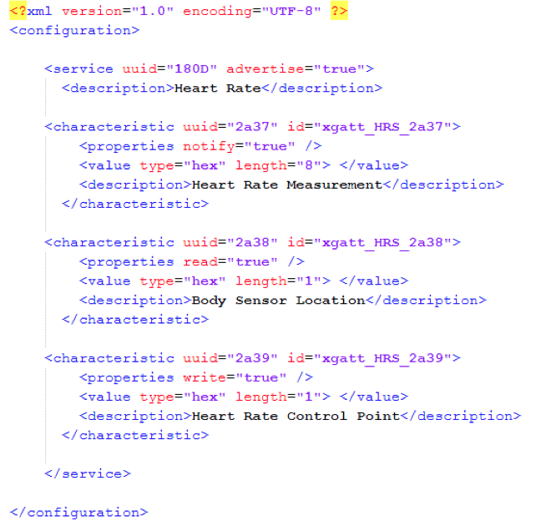
Example gatt.xml File
Notes:
NOTE: If advertise="true" is not set in the service, the iPhone4S may not be able to discover the device.

Slide 6
BGScript Project Structure
project.xml
hardware.xml
gatt.xml
Database structure
Security settings
glucose.bgs
Main application logic
Event detection
I/O detection, display updates, sensor reading

Slide 7
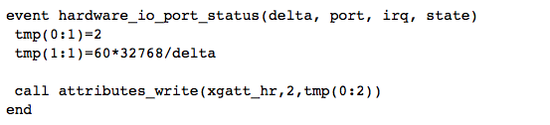
BGScript Projects
Allows for on-module applications, eliminating the need for an external host controller
BGScript is similar to BASIC
Code can be developed using an text or source code editor
Code is executed in response to event messages
Lines are executed in order
Events need to be defined and finished with an end statement
Notes:
Details of implementing BGSCripts programs can be found in BGScript users guide. Examples are available in SDK.

Slide 8
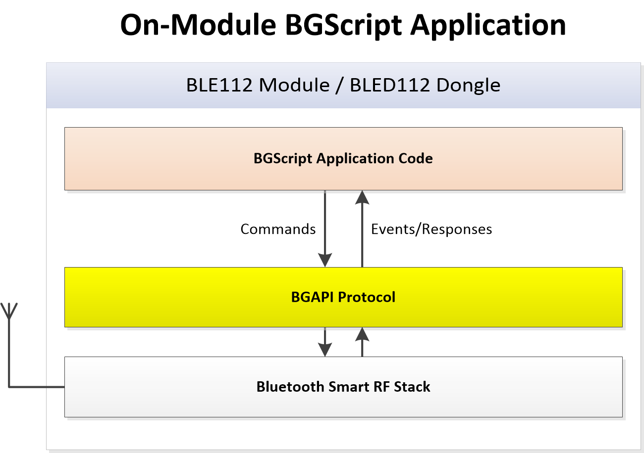
BGScript Architecture
Notes:
Details of implementing BGSCripts programs can be found in BGScript users guide. Examples are available in SDK.

Slide 9
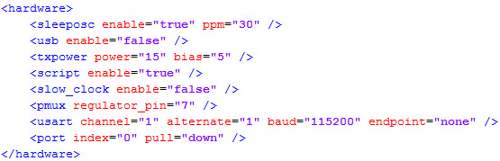
Hardware setup for BGScript Project
Enable BGScript (not BGAPI)
Enable low-power sleep modes
Enable UART if desired (e.g. debug data, external comms)
Enable SPI if desired (e.g. onboard display output)
Enable PORT 0 pull-down

Slide 10
BGAPI Projects
BGAPI is binary API for use in applications where external host processor is needed.
Binary commands are issued over UART or USB to BLE112 module
Binary commands compiled into C library (BGLIB)
BGLIB can be recompiled for specific host platforms
Example – Arduino implementation
Example Binary API projects contained with SDK
BGScript examples can be used as reference for BGAPI applications
Notes:
Details of implementing BGSCripts programs can be found in BGScript users guide. Examples are available in SDK.

Slide 11
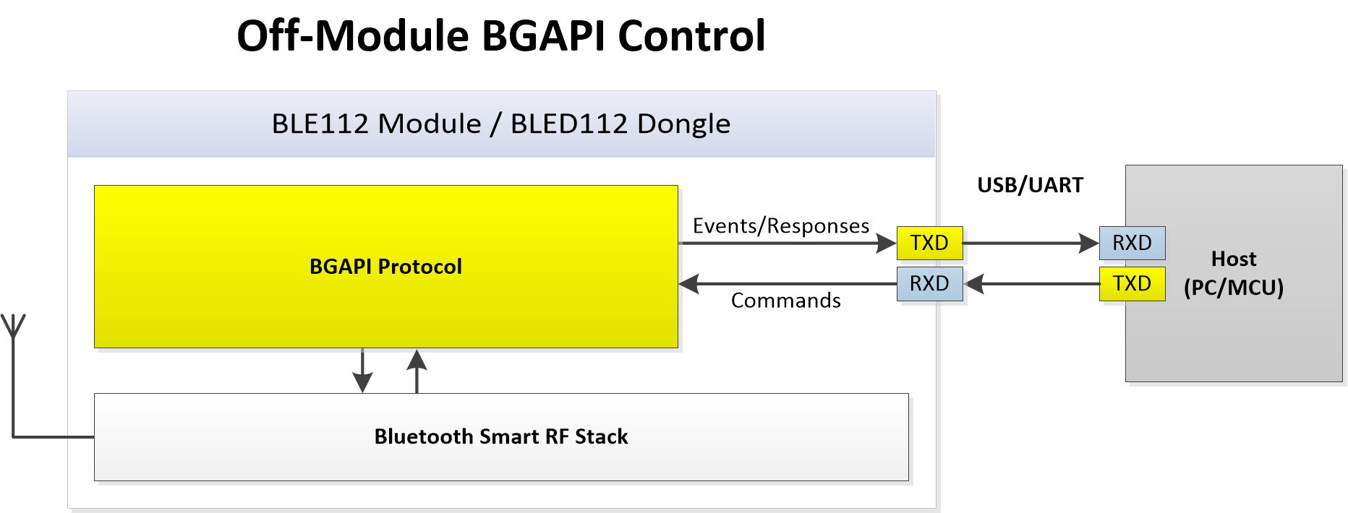
BGAPI Architecture
Notes:
Details of implementing BGSCripts programs can be found in BGScript users guide. Examples are available in SDK.

Slide 12
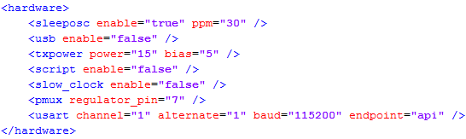
Hardware setup for BGAPI Project
Configure BGAPI on UART or USB
Other settings generally the same as BGScript project

Slide 13
Glucose Project Example

Slide 14
Glucose Project Structure
<project>
<gatt in=“gatt.xml” />
<hardware in=“hardware.xml” />
<script in=“glucose.bgs” />
<usb_main in=“cdc.xml” />
<image out=“out.hex” />
</project>

Slide 15
Glucose Hardware.XML Structure
<hardware>
<sleeposc enable="true" ppm="30" />
<usb enable="false" />
<txpower power="15" bias="5" />
<script enable="true" />
<slow_clock enable="false" />
<pmux regulator_pin="7" />
<usart channel="0" mode="spi_master" alternate="2" polarity="positive“
phase="1" endianness="msb" baud="57600" endpoint="none" />
<usart channel="1" alternate="1" baud="115200" endpoint="none“
flow="false" />
<port index="0" pull="down" />
</hardware>

Slide 16
Glucose Profile GATT Structure
Generic Access Service
Device Name and Appearance
Glucose Service
Glucose Measurement
Glucose Measurement Context (optional)
Glucose Feature
Record Access Control Point
Device Information Service
Manufacturer Name
Model Number
System ID

Slide 17
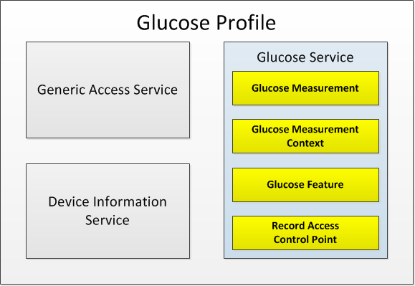
Glucose Profile GATT Structure

Slide 18
BGScript Event Code Overview
System Boot – on startup
Connection Status – connect/disconnect
Attribute Write – remote updates from iOS
Hardware I/O Status – button presses
Hardware Timer – background updates
ADC Result – data read from ADC

Slide 19
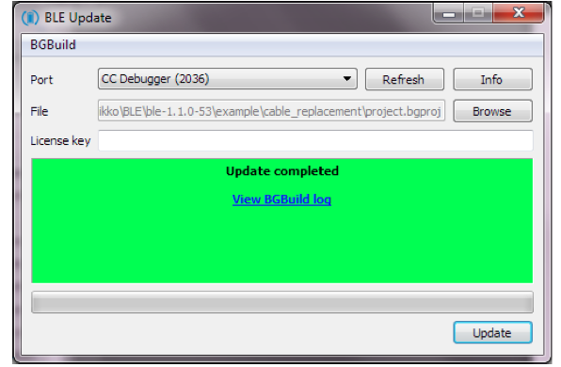
Compiling and installing the project onto a BLE112
Recommended Approach
USE BLE Update tool found on Bluegiga’s Tech Forum
Connect CC Debugger to module
Press button on CC Debugger and make sure LED turns green
Start BLE Update Tool
Make sure CC Debugger is shown in port dropdown list
Browse to find your project
Press update
Notes:
TI Flash tool should NOT be used with the Bluegiga Bluetooth Smart SDK v.1.1 or newer, but BLE Update tool should be used instead. The BLE112 and BLED112 devices contain a security key, which is needed for the firmware to operate and if the device is programmed with TI flash tool, this security key will be erased.

Slide 20
Glucose Demo Usage
Advertising enabled after power-on
Connection with bonding enabled
Current status always displayed on LCD
Potentiometer: Set glucose measurement
P0_0 button: Initiate glucose reading
P0_1 button: Reset all saved data/bonding
iOS first/last/all record retrieval from flash

Slide 21
Thank you!

